Slide 1




API Compare and Contrast
January 11, 2017

Slide 2
WELCOME!
About Us: Learning how to created full-stack, scalable internet applications. From the database… all the way to front-end user interfaces : JavaScript Frameworks • Server-Side Code • Load Balancing
Meetup Calendar:
https://www.meetup.com/SaintLouis_FullStack_WebDevelopment/events/
Slack Group(s):
https://stlfullstackwebdev.slack.com
https://stl-tech.slack.com/messages/stl_fullstack_web_dev/

Slide 3


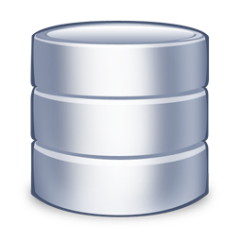

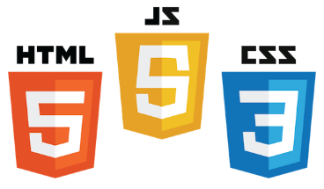



FULL STACK
1. CLIENT SIDE
2. SERVER SIDE

Slide 4
API BASICS
API’s are a nice way to decouple development of the Full Stack components from the previous slide…
Some basic shit about API’s…. CONTRACT
JSON or XML
REST vs. SOAP

Slide 5
NO API…
1. CLIENT SIDE
2. SERVER SIDE

Slide 6

NO API…
1. CLIENT SIDE
2. SERVER SIDE

Slide 7
NO API…
1. CLIENT SIDE
2. SERVER SIDE

Slide 8

NO API…
1. CLIENT SIDE
2. SERVER SIDE

Slide 9
NO API…
1. CLIENT SIDE
2. SERVER SIDE

Slide 10
NO API…
1. CLIENT SIDE
2. SERVER SIDE

Slide 11
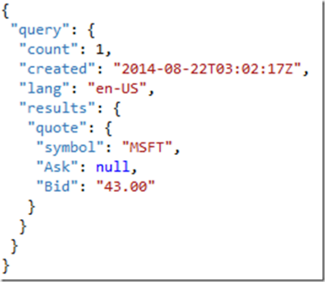

WITH API
1. CLIENT SIDE
2. SERVER SIDE

Slide 12
WITH API
1. CLIENT SIDE
2. SERVER SIDE

Slide 13
WITH API !!!
1. CLIENT SIDE
2. SERVER SIDE

Slide 14
REST
Representational State Transfer (or something like this)
Some basic shit about REST….
Resources
Routes
GET
POST
DELETE
PUT or PATCH

Slide 15
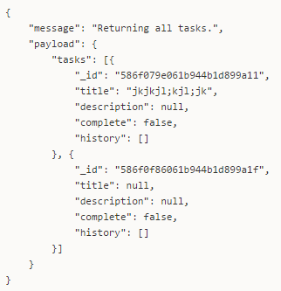
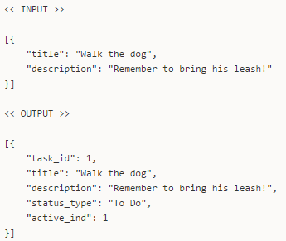
API CONTRACT
1. GET /tasks
2. POST /tasks
3. PATCH /tasks/{id}
4. DELETE /tasks/{id}

Slide 16

TODO APP
We implemented basic REST API concepts in a ToDo app
Features of the app…
How it works…
Multiple Full Stacks (identical Front-End’s)
Can we talk about Vue on this slide? Or does it need its own?

Slide 17

MULTIPLE FULL STACKS
#1
#2
#3
#4
Front-End
API Layer
Database

Slide 18

NODE.JS + MONGODB
Server-side JavaScript Framework
Web Server and more
Asynchronous
NoSQL Document Database
Replication
Sharding

Slide 19
FLASK + SQLITE
Lightweight RESTful framework (like Slim!)
Written in Python
Super Fast
Small Relational Database (like a mini-PostgreSQL!)
Used in Mobile
xxxx

Slide 20
SLIM PHP + POSTGRESQL
Lightweight RESTful framework
Written in PHP
Super Fast
Relational Database System
Feature-Rich
Free and Open Source

Slide 21

DJANGO + ???
Full-Fledge Web Framework
Written in Python
Not as fast as Flask… but Feature-Rich!
????
????
????

Slide 22


DEMOS!!!

Slide 23
NEXT STEPS
ADDITIONAL FEATURES:
Due Dates
Logins / Permissions
Recurring Tasks
Task Dependencies
Error Handling and Reporting
Better Development Practices

